Slide 1
Inventory Tools:
How to use
Asset Tiger
Property Accounting
Danya Curtis & Carla Rutherford

Slide 2
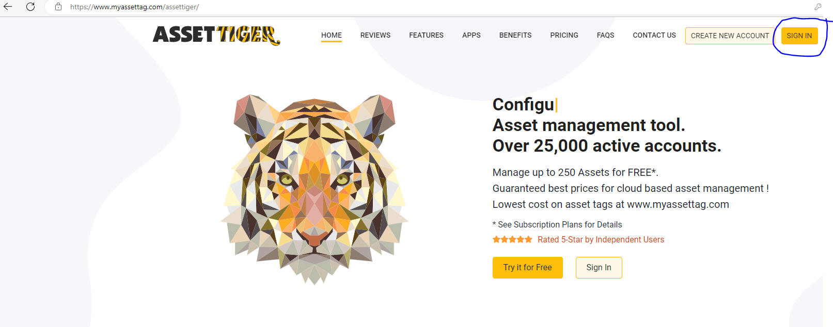
Asset Tiger Log In
https://www.myassettag.com/assettiger
Username: (your departments abbreviation) inventory@uada.edu
Example: enplinventory@uada.edu
Password: AssetTiger2021!
Let property accounting know if you have issues logging in to Asset Tiger. DO NOT CHANGE PASSWORDS! Multiple users will be utilizing the inventory lists. If you change the password, it puts extra work on IT.

Slide 3
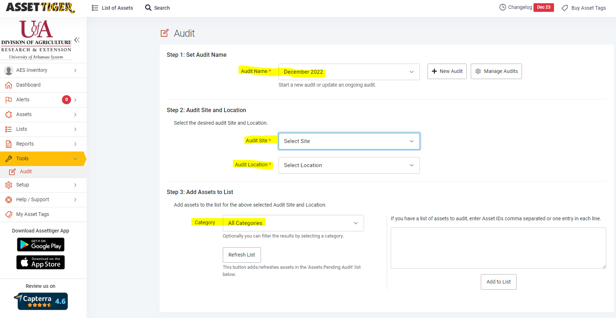


Asset Tiger Tabs to Locate Audit
Tools (on left side of screen)
Audit (under tools)
  Step 1: Set Audit Name-Select December 2022 from the drop-down list
  Step 2: Audit Site and Location
    Part 1 of Step 2: Audit Site is required and should correspond to the site you are auditing (AES, CES, or Division).
    Part 2 of Step 2: Audit Location is required and should correspond to with the name of the business asset tracker for your cost center (Example: AES would select the name Heather Frankenberger).
3. Step 3: Add Assets to List
    This auto defaults to “all categories.” Leave all categories and hit refresh list tab.

Slide 4
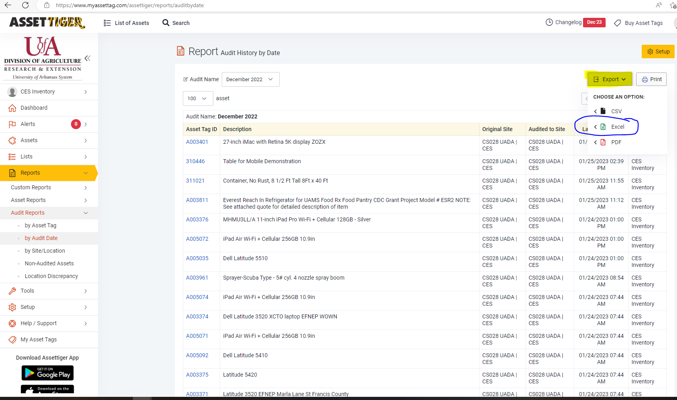
Asset Tiger Reports
Reports (on left side of screen)
Audit Reports(under tools)
  I use “by Audit Date” to view all audited assets for a department.
  Additional reports are available including “Non-Audited Assets.” This will give a quick view of all assets remaining to be audited.
Please note that all reports can easily be exported to Excel through the Export tab on the right side of the report.

Slide 5
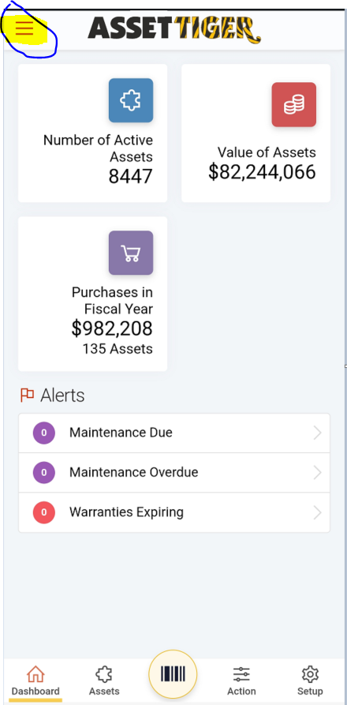
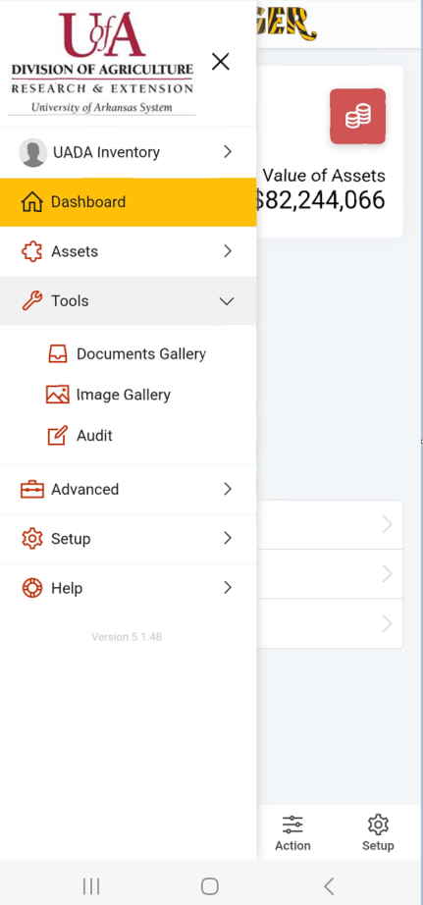
Asset Tiger Mobile Scanning Tool
Download Asset Tiger onto your mobile device (cell phone, iPad, etc.).
Log In just as you would from your computer onto the Asset Tiger website.
Once logged into Asset Tiger your screen will look like the photo on the left side of the screen.
Click on three lines at the top of the left side of your mobile screen (beside the title “Asset Tiger” to view the options for the mobile site (please see the right side of this slide for a sample picture).

Slide 6
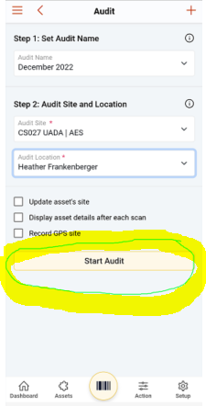
Asset Tiger
Mobile Scanning Tool
Under Tools select “AUDIT.”
Two steps (see below).
  Step 1: Set Audit Name-Select December 2022
  Step 2: Audit Site and Location
    Part 1 of Step 2: Audit Site is required and should correspond to the site you are auditing (AES, CES, or Division).
    Part 2 of Step 2: Audit Location is required and should correspond to with the name of the business asset tracker for your cost center (Example: AES-DREX would select the name Heather Frankenberger).
Select “Start Audit” tab in the middle of your mobile screen.

Slide 7
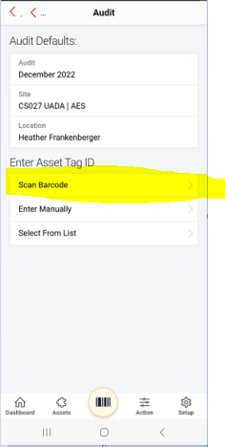
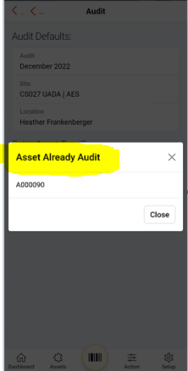
Asset Tiger Mobile Scanning Tool
You can verify that all information is correct from this screen.
Once information is verified, select “Scan Barcode.”
You will then receive a message on your screen letting you know if the asset was successfully audited, previously audited, or asset not found. If the asset shows as not found, do not add assets instead reach out to property accounting.
Repeat the “Scan Barcode” step for all assets.
Please note that Asset Tiger can scan from a picture of the barcode (you can have people send pictures to you via email or text message) and multiple users can scan at one time with the log in information.

Slide 8
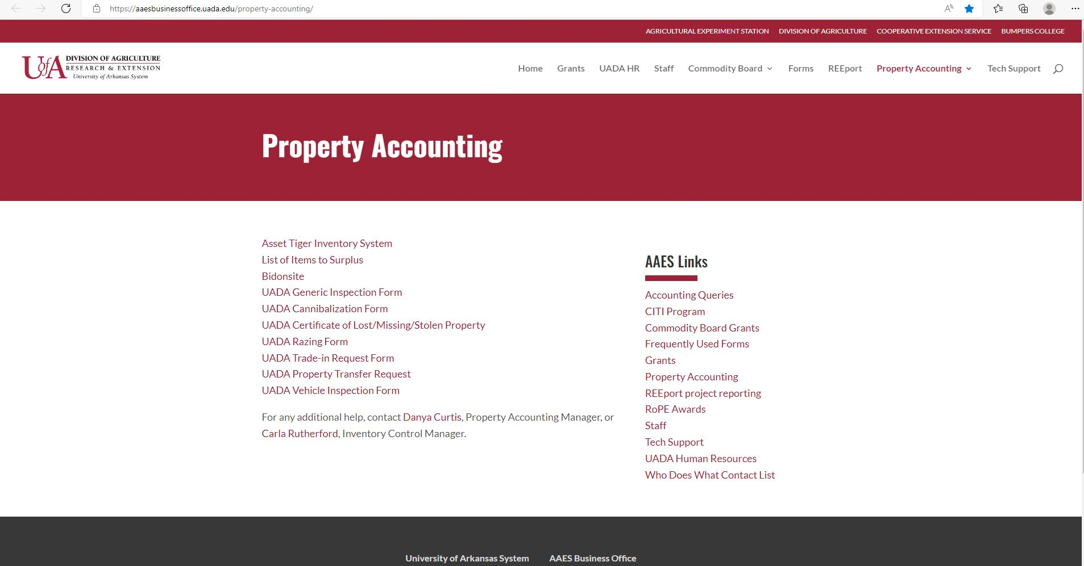
Property Accounting Forms
All property accounting forms are now fillable PDF’s.
A link to Asset Tiger Inventory System is available under the Property Accounting Tab on the business office website.
A tutorial video is also available at the same location.
Forms are located on the AAES Business Office Website under the property accounting tab.
https://aaesbusinessoffice.uada.edu/property-accounting/

Slide 9

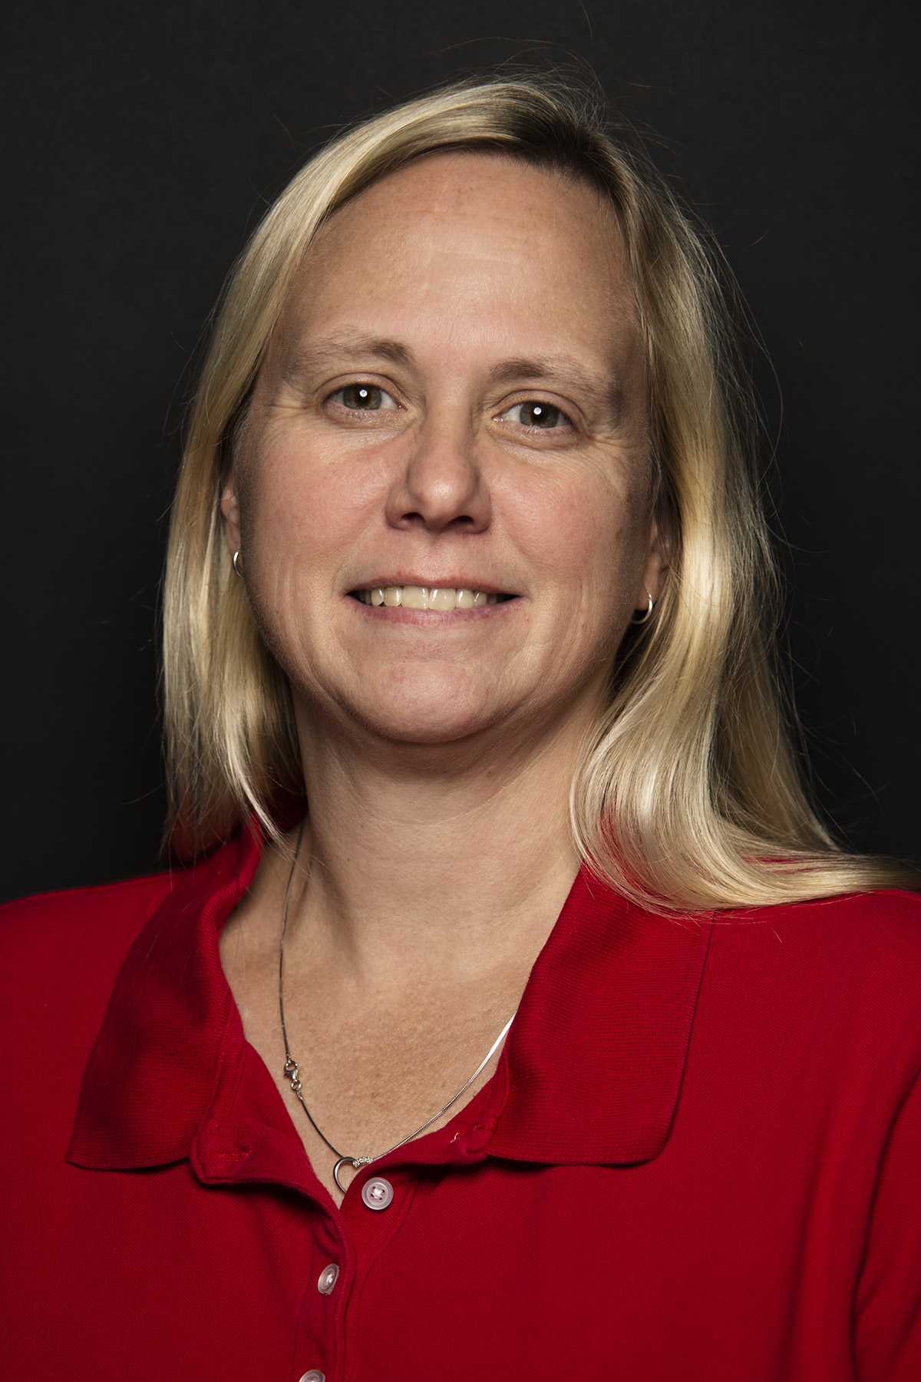
Contact Information
Danya Curtis, Property Accounting Manager
Don Tyson Annex
2549 N Hatch Ave
Fayetteville, AR 72701
Office Phone: (479) 502-9709
Email: dacurtis@uada.edu
Carla Rutherford, Inventory Control Manager
Don Tyson Annex
2549 N Hatch Ave
Fayetteville, AR 72701
Office Phone: (479) 575-2542
Email: crutherford@uada.edu

