Slide 1
Surplus
&
Inventory
Property Accounting
Danya Curtis & Carla Rutherford

Slide 2
Topics
Request for Certificate of Property Disposal (CPD)
Surplus Disposal Form (SDF)
FY23 Inventory

Slide 3
Request for Certificate of Disposal (CPD)
Types of Disposals
Cannibalization
  easiest type of disposal to submit. Destruction of Property gives us permission to destroy property.
Scrap is a viable option for items that are primary constructed out of metal. The Office of Marketing and Redistribution will often deny placing assets in the metal bin based on required pictures.
Sale on Site of Large Scrap Metal Assets (example feed silo with only scrap metal value)
  Property of resale value that it is not feasible to transport.
  The M&R Manager determines if it is feasible to transport. M&R almost always makes us try to surplus before they will approve a scrap disposal for larger items.
  We are required to submit three bids for removal of this type of item.
Computer and Electronic Equipment E-Cycle

Slide 4
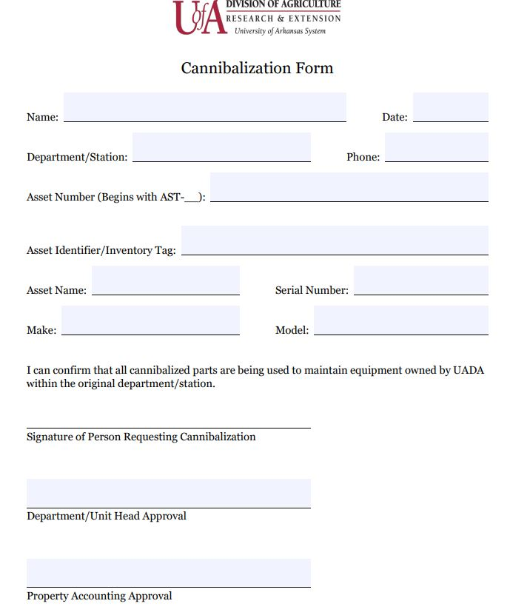
Cannibalization Form
Complete a Cannibalization Form for any assets that you wish to remove from inventory but want/need to keep parts from the equipment
Email form with 3-4 pictures of asset to property@uada.edu
We will do the rest!

Slide 5
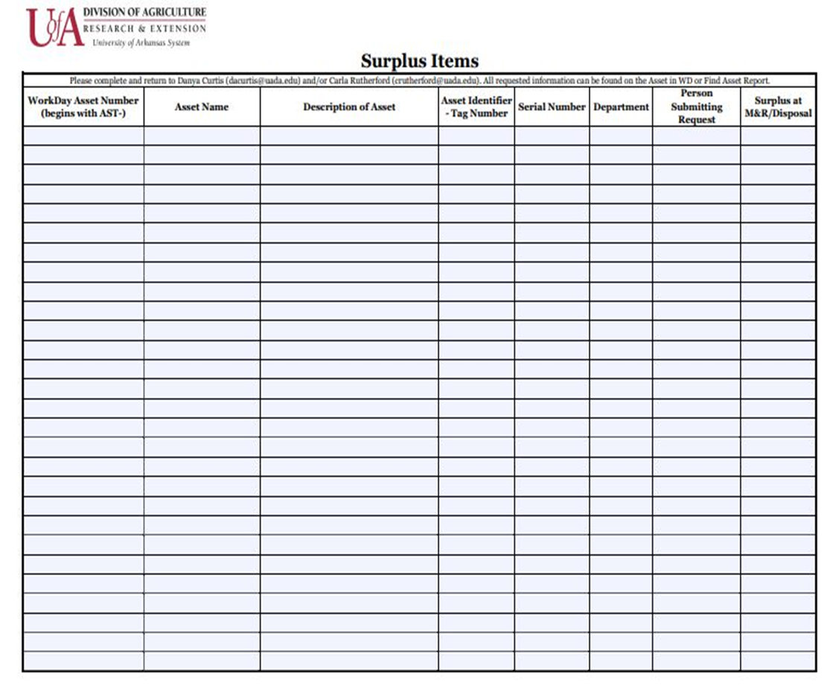
Steps for Other CPD’s
Complete a Surplus List
  Enter the desired disposal type (metal bin, large item scrap, or e-cycle) in the last column
  9 out of 10 times M&R will require a sale attempt before they will allow us to dispose of large items for scrap metal
Email form with 3-4 pictures of asset to property@uada.edu
We will do the rest!

Slide 6
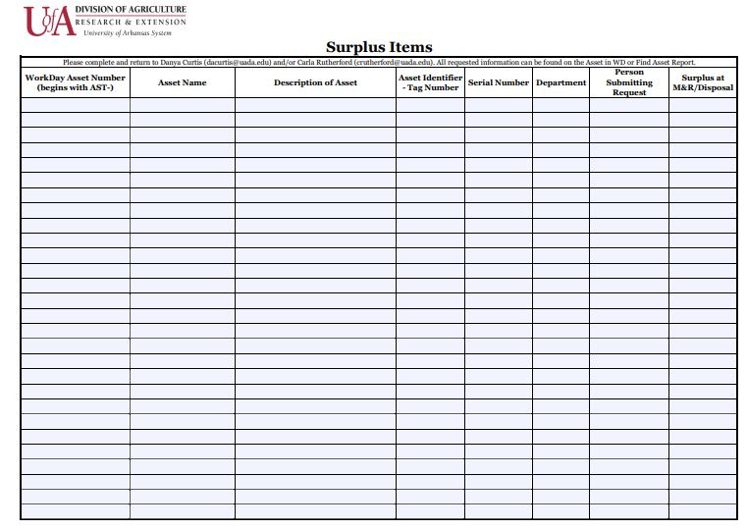
Steps for Surplus
Complete a list of items to surplus-use WorkDay to fill in the necessary information on the forms
  All UADA assets (tagged or untagged) must go through the surplus process!
  Examples: Computers, Equipment
  Ask us before you do anything with tagged or untagged items.
Email form with 3-4 pictures of asset to property@uada.edu
We will do the rest!

Slide 7
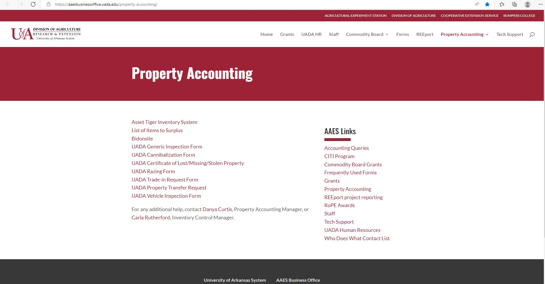
Property Accounting Forms
All property accounting forms are now fillable PDF’s.
Forms are located on the AAES Business Office Website under the property accounting tab.
https://aaesbusinessoffice.uada.edu/property-accounting/

Slide 8
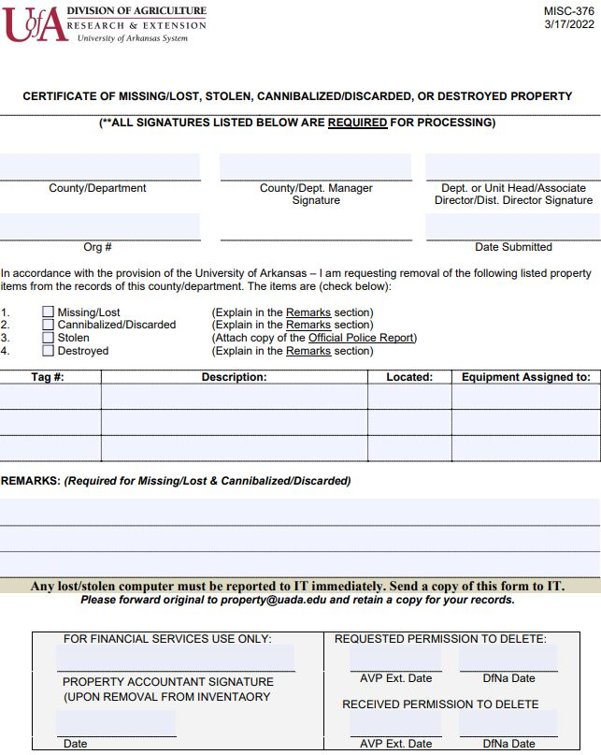
Certificate of Missing/Lost/Stolen Property Form
Complete Certificate of Missing/Lost/Stolen Property Form
Email form to property@uada.edu
We will do the rest!

Slide 9
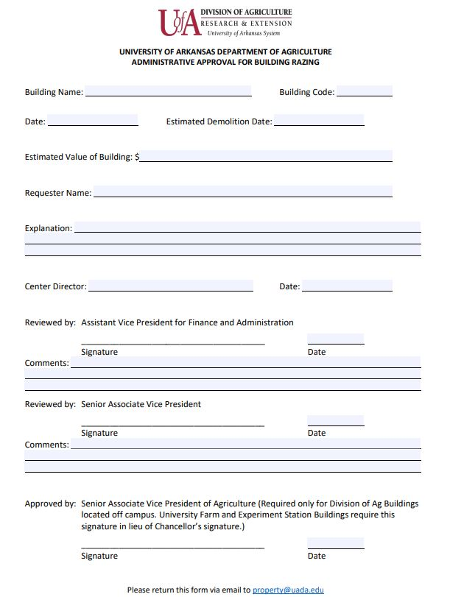
Building Razing Form
Complete UADA Administrative Approval for Building Razing Form
Email form to property@uada.edu
We will do the rest!

Slide 10
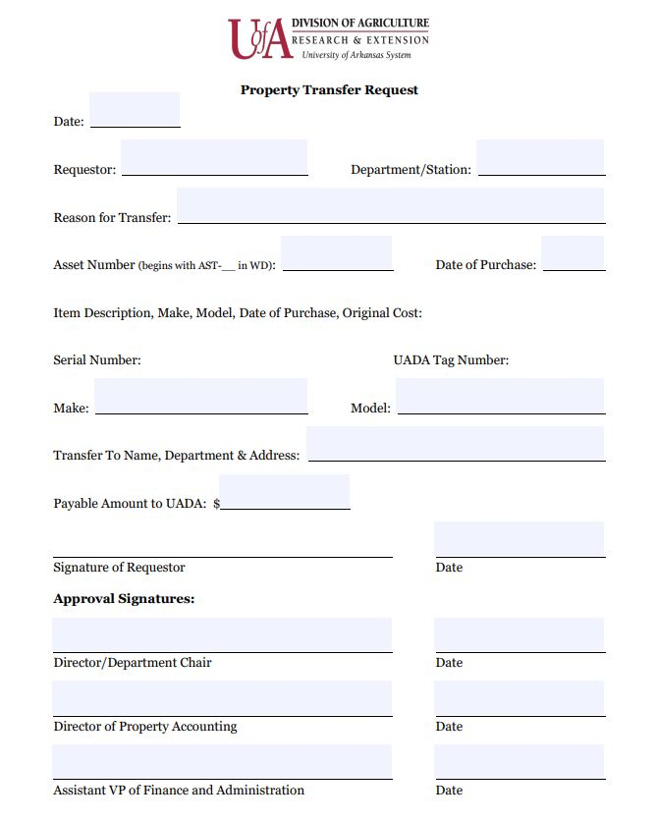
Property Transfer
Request
Complete Property Transfer Request
Email form to property@uada.edu
We will do the rest!

Slide 11
New Processes for M&R
M&R keeps the first $20,000.00 collected from each agency.
February 2022 was the effective date for this new process.
To keep everything fair for all, we will return funds based on the percentage of assets sold for each calendar year.
If Animal Science sells 10% of the total value of all assets sold by M&R for UADA in a calendar year, then Animal Science will be responsible for 10% of the $20,000.
The remaining funds will be deposited in the in the appropriate cost center (date to be determined-but after the first of January).

Slide 12
Fiscal Year 2023 Inventory
2023 UADA Inventory
We will be requiring an inventory of all assets.
Timeline
Available in Asset Tiger Inventory System Tiger on November 7, 2022
Due Date for all of inventory prior to Christmas break 2022.

Slide 13
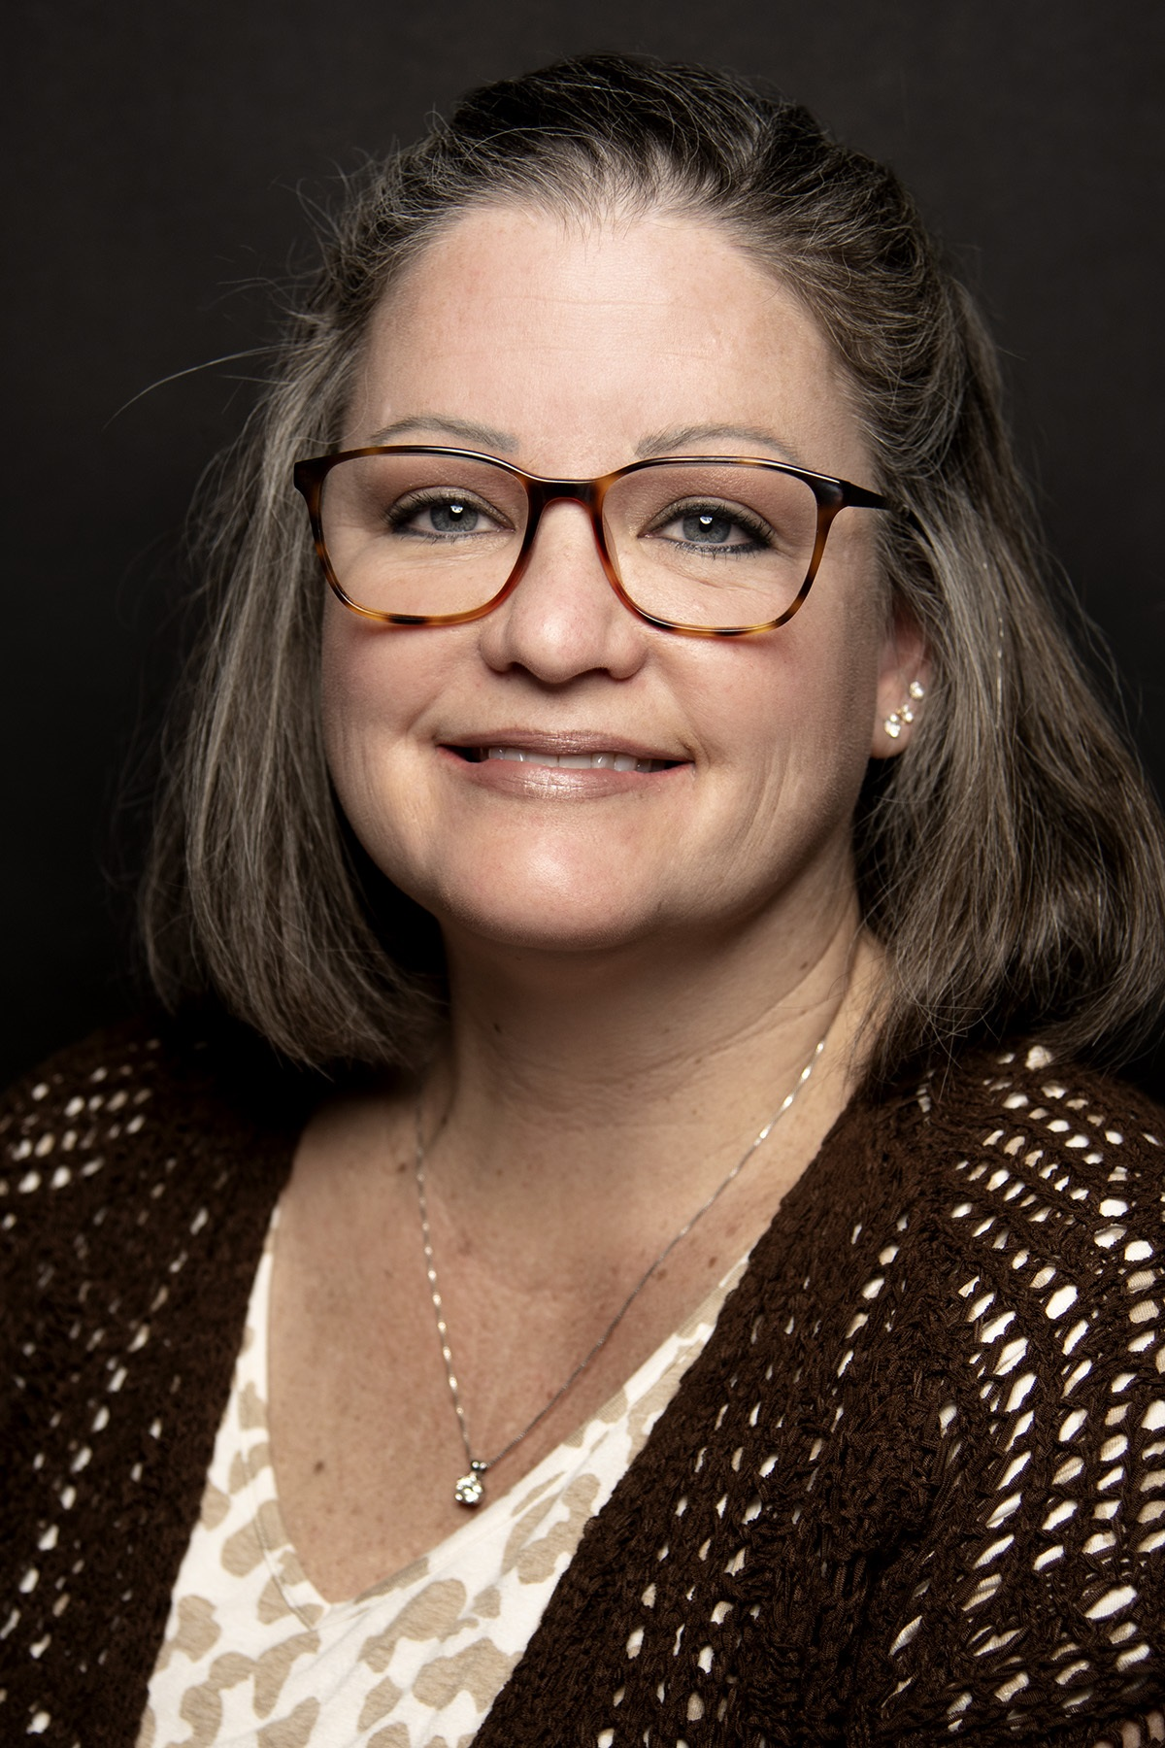
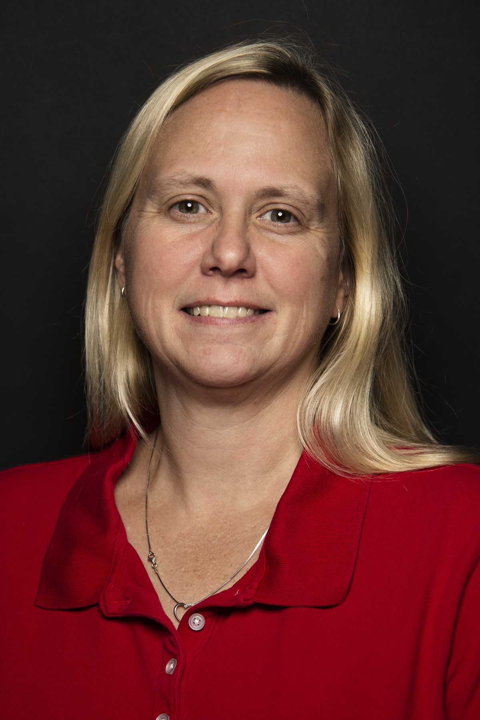
Contact Information
Danya Curtis, Property Accounting Manager
Don Tyson Annex
2549 N Hatch Ave
Fayetteville, AR 72701
Office Phone: (479) 502-9709
Cell Phone: (479) 575-0581
Email: dacurtis@uada.edu
Carla Rutherford, Inventory Control Manager
Don Tyson Annex
2549 N Hatch Ave
Fayetteville, AR 72701
Office Phone: (479) 575-2542
Email: crutherford@uada.edu

