Slide 1
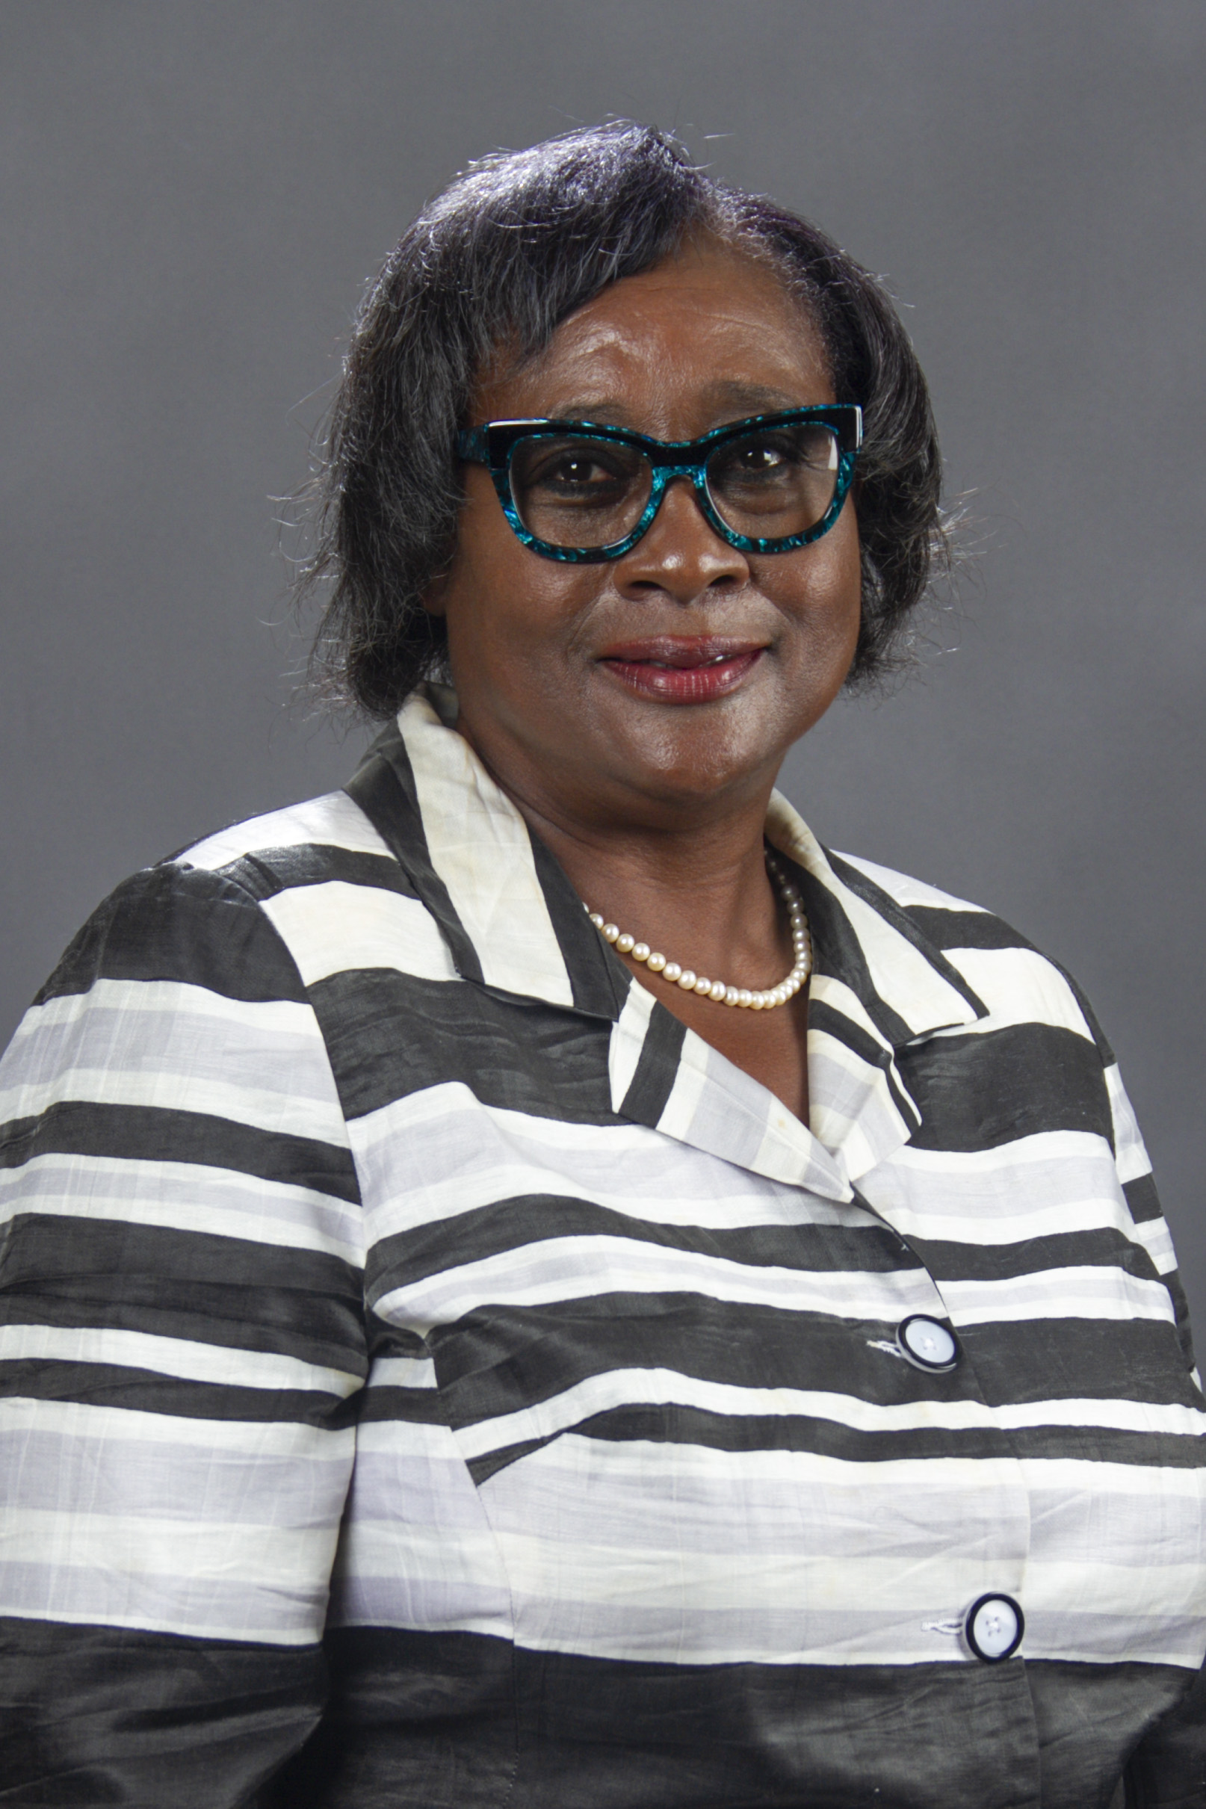

Expand your horizons!
The LeadAR experience was the "change" that allowed me to stretch and discover horizons that I would not have otherwise considered. As a result, I grew personally and professionally and am now a champion for improving the status quo.
Diane Tatum
Regional Manager, Entergy (retired)
Class 8 - Pine Bluff

